Slide 1


Slide 2

VISION
Impact DuPage is committed to creating a common understanding of community needs, gaps, and priorities that will advance the well-being of the DuPage County community.
Notes:
The partners created this vision.

Slide 3
PROCESS
AUG 2013
MAY 2014
JUN 2014
DEC 2014
JAN 2015
DEC 2015
JAN 2016
JAN 2018
DEC 2018
SELECT INITIAL STRATEGIC ISSUES
NEW ASSESSMENT AND ACTION PLAN
FORMULATE
GOALS AND STRATEGIES
ORGANIZE AND CREATE A VISION
COMPLETE ASSESSMENTS
Action Cycle

Slide 4
STEERING COMMITTEE MEMBERS
DuPage County Health Department
DuPage Federation on Human Services Reform
United Way of DuPage/West Cook
AMITA Health
DuPage County Community Services
Edward-Elmhurst Healthcare
DuPage Health Coalition
Metropolitan Family Services DuPage
Northwestern Medicine
DuPagePads
DuPage Foundation
DuPage Medical Group
Advocate Good Samaritan Hospital
DuPage County Public Defender’s Office
Community Consolidated School District 89
Notes:
The Steering Committee is currently comprised of the following organizations.

Slide 5
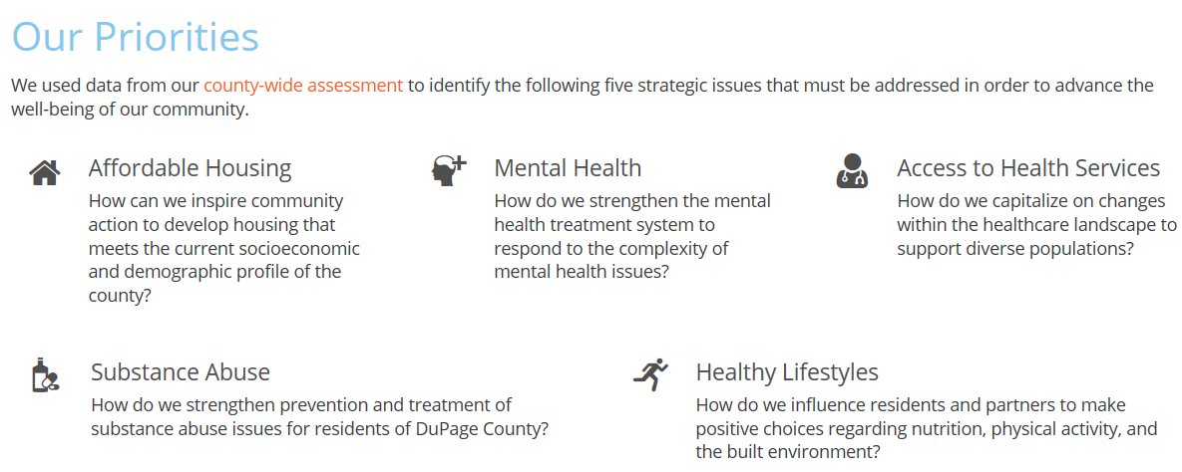
STRATEGIC
ISSUES
We used data from our county-wide assessment to identify the following 5 initial strategic issues that must be addressed in order to advance the well-being of our community.

Slide 6
CROSS CUTTING ISSUES INFLUENCING HEALTH
FOOD SECURITY

Slide 7
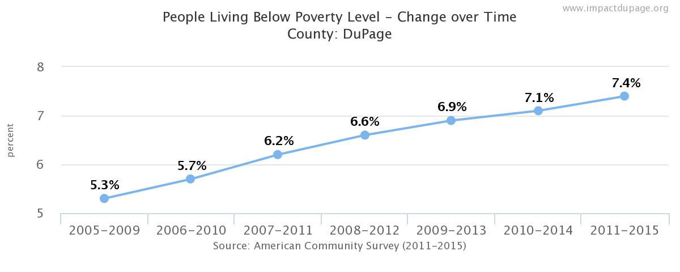
DUPAGE DATA
Poverty
Feeding America, 2015

Slide 8
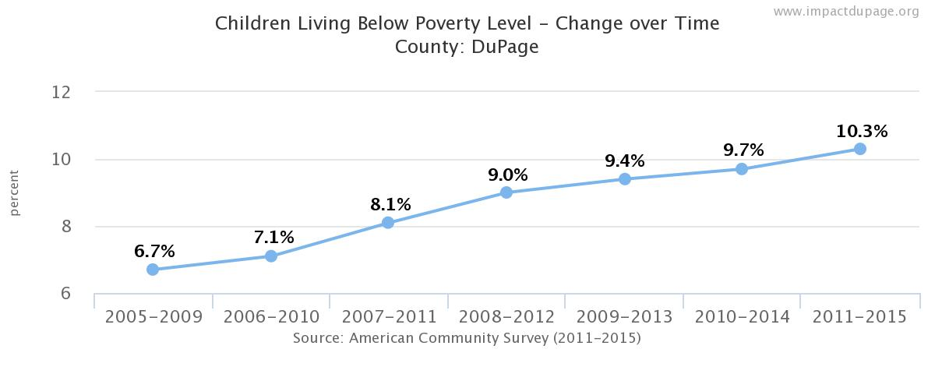
DUPAGE DATA
Children in Poverty

Slide 9
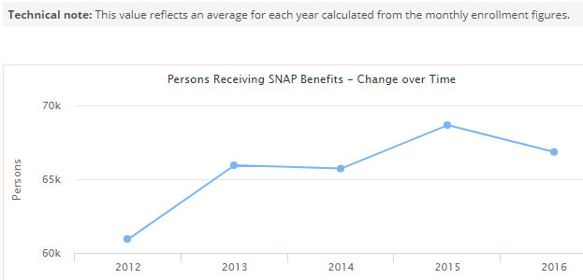
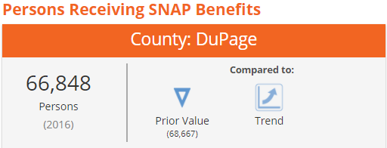
DUPAGE DATA
Persons Receiving SNAP Benefits

Slide 10
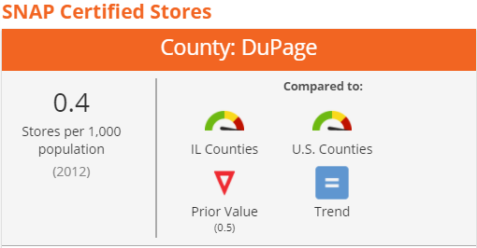
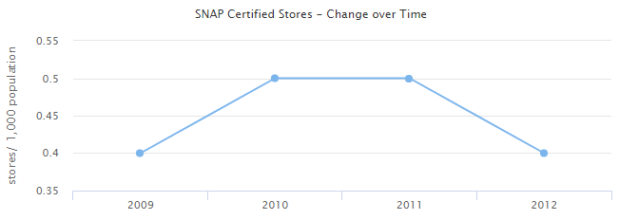
DUPAGE DATA
SNAP Certified Stores

Slide 11
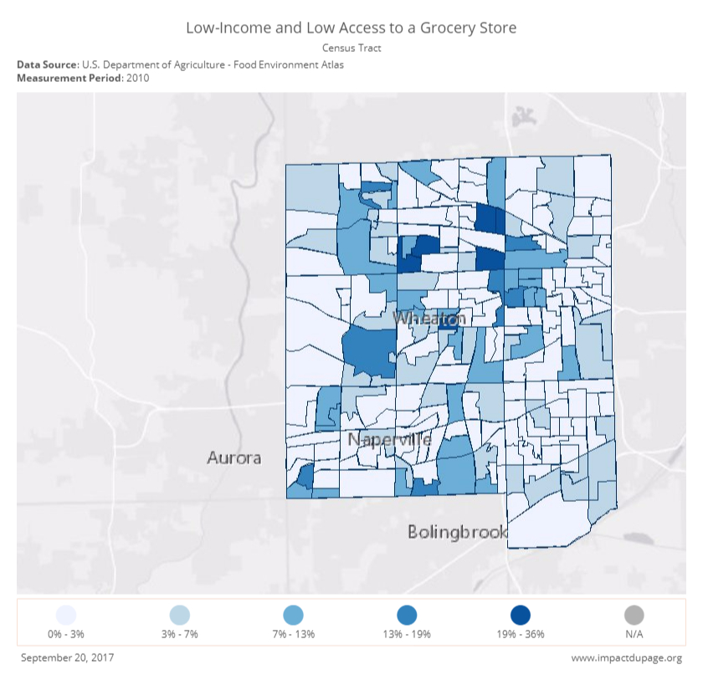
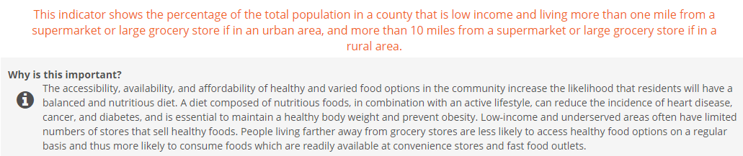
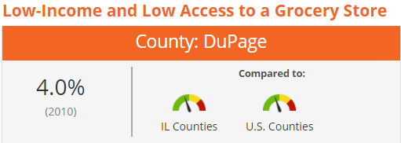
DUPAGE DATA
Low Income and Low Access to a Grocery Store

Slide 12
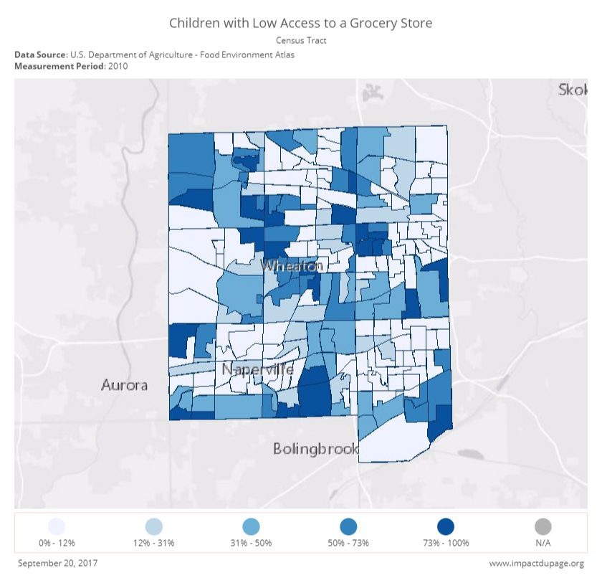
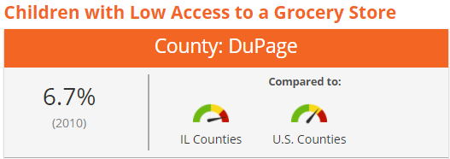
DUPAGE DATA
Children with Low Access to a Grocery Store

Slide 13
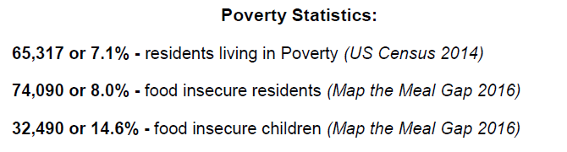
DUPAGE DATA
Food Insecurity
Northern Illinois Food Bank, DuPage Snapshot, 2016

Slide 14
DUPAGE DATA
Low-Income Obesity
In 2015, 15.5% of children ages 2-4 enrolled in WIC in DuPage County were obese, compared to a United States WIC population value of 14.5%.

Slide 15
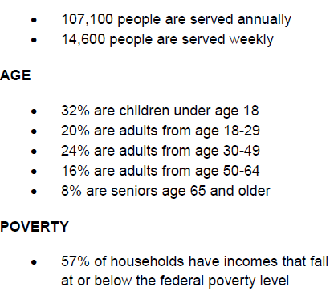
DUPAGE DATA
NIFB Served, 2014
Northern Illinois Food Bank, DuPage Snapshot, 2016

Slide 16
DUPAGE DATA
Benefits
30.3% of public school students in DuPage County are eligible for the Free Lunch Program
In 2016, an average of 66,848 residents were enrolled in the Supplemental Nutrition Assistance Program (SNAP).
National Center for Education Statistics, 2014-2015
Illinois Department of Human Services, 2016

Slide 17
DUPAGE DATA
STILL A NEED EXISTS…

Slide 18
HUNGER VITAL SIGN
Identifies individuals and families as being at risk for food insecurity
2 question screening tool
Within the past 12 months we worried whether our food would run out before we got money to buy more.
Within the past 12 months the food we bought just didn’t last and we didn’t have money to get more.
Notes:
Developed by Children’s Health Watch in 2010
At risk for food insecurity if they answer either or both statements as “often true” or “sometimes true” vs “never true”
In October 2015, the American Academy of Pediatrics released a policy statement recommending that pediatricians screen all children for food insecurity
CMS uses Hunger Vital Signs in its Accountable Health Communities screening tool
Anyone who works with young children can use the tool (e.g. healthcare providers, social service providers, community-based outreach workers, teachers, etc.)
http://childrenshealthwatch.org/public-policy/hunger-vital-sign/

Slide 19
SCREENING TOOLS IN THE FIELD
Addison Early Childhood Collaborative Parent Survey, 2015-2016
Included questions screening for food insecurity, 135 responses
49% answered “often true” or “sometimes true” for how often in the past 12 months was family worried about whether food would run out before there was money to buy more
37% reported that in the past 12 months, the food they had sometimes or always ran out before there was money to buy more

Slide 20
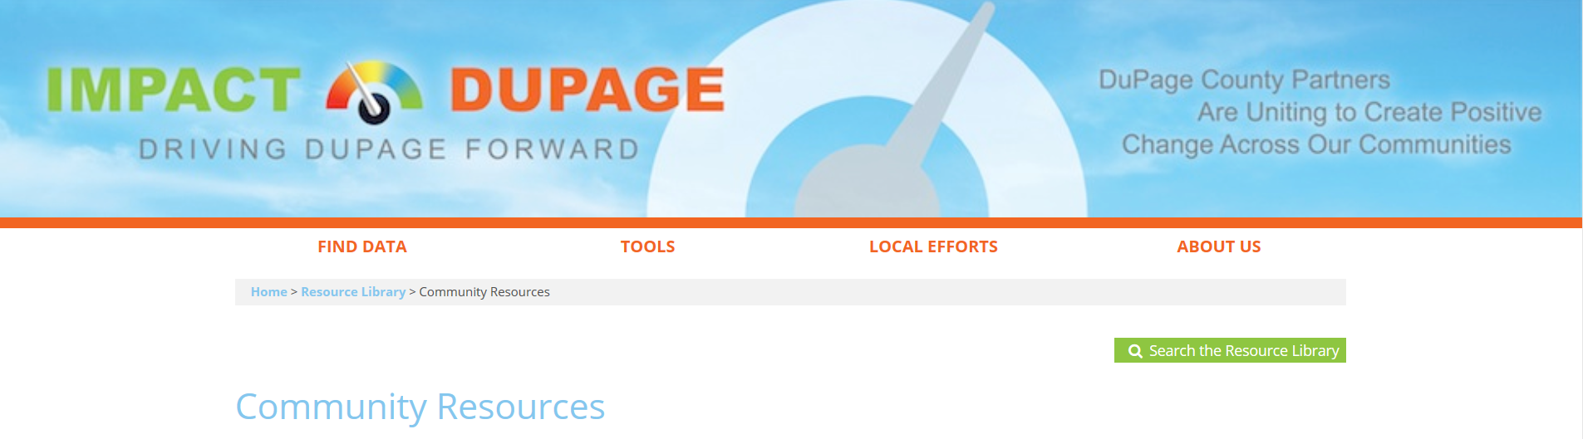

RESOURCES
Notes:
Impact DuPage links to the DuPage CRIS.
A food pantry search tool is also available on the Community Hunger Network Website.

Slide 21
Special Thanks…
Candace King, Executive Director
Jordan Durrett, Data Analyst
DuPage Federation on Human Services Reform
Weija Chang, Area Specialist
Northern Illinois Food Bank

Slide 22
Karen Ayala, MPH
Executive Director
DuPage County Health Department
kayala@dupagehealth.org
630.221.7401
Sarah Troll, MPH
Population Health Coordinator
Sarah.troll@dupagehealth.org
630.221.7147

