Slide 1
Access
OF WEST MICHIGAN
www.AccessofWestMichigan.org

Slide 2
MISSION
Access strengthens and develops wholistic solutions to poverty by cultivating equitable systems through education and collaboration

Slide 3
Overview
History
The U.S. Food System
The Charitable Food System
Access of West Michigan
The Paradigm Shift
What we came to realize
What we’re doing about it
Reframing the Narrative
Vision and Values

Slide 4
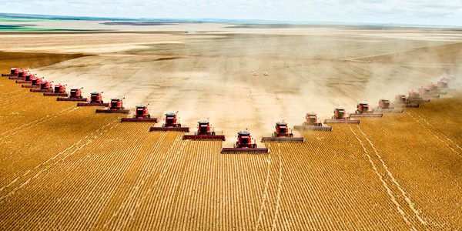
History

Slide 5
History

Slide 6
History
The Results?
Exploitation of humans, the earth, & animals
Lack of regard for health & well-being
Food as commodity

Slide 7
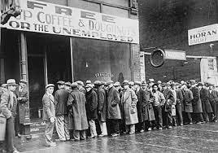
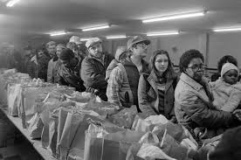
History
The Charitable Food System
1930’s
1980’s

Slide 8
History
The Charitable Food System
Big Food Corporations benefit
Health disparity
Institutionalization
“We can & must do better than this”

Slide 9
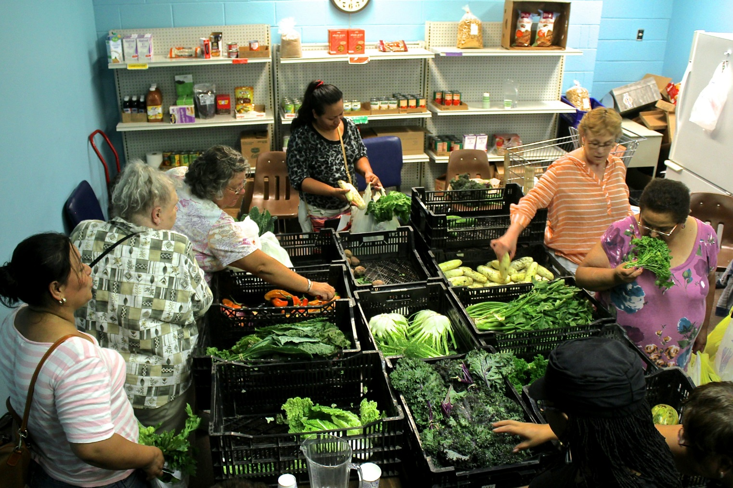
Shifting Paradigms
From food to food system

Slide 10
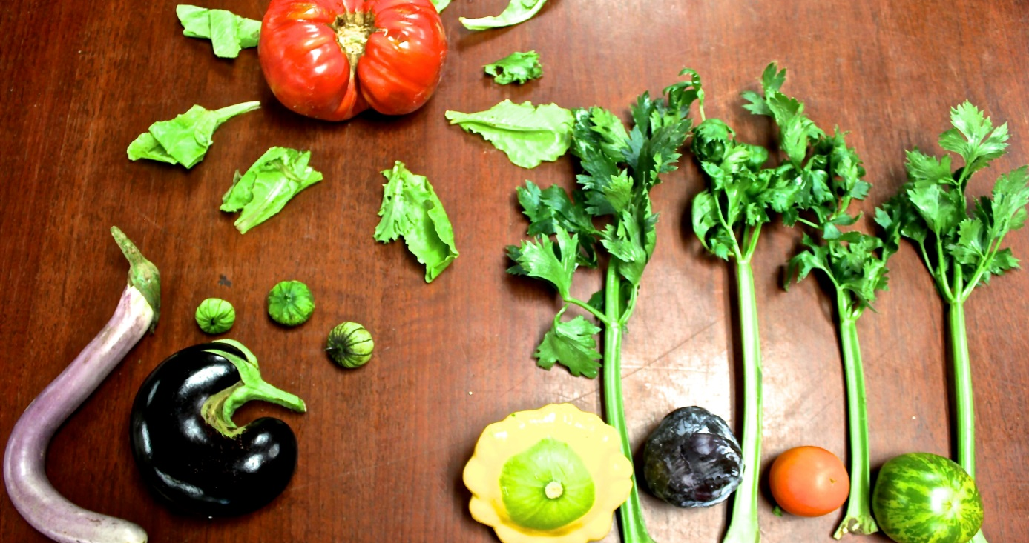
Vision vs. Reaction
Food Security vs. Thriving Food System
Goals & Life Cycle

Slide 11
The Paradigm Shift
The Michigan Good Food Charter
Healthy, Green, Fair, Affordable
Impact
Outcomes vs. outputs
Clearly measured changes & improvements in Food System
Community Development Principles

Slide 12
Growing Health
Policy, Systems, and Environmental Change
Healthy Food Policy
Environmental shifts in community centers
Adding new system of healthy & affordable food
Nutritional Options for Wellness Program (NOW)
Low-income patients with diabetes or cardiovascular disease
One year healthy lifestyle curriculum
Coaching & goal setting

Slide 13
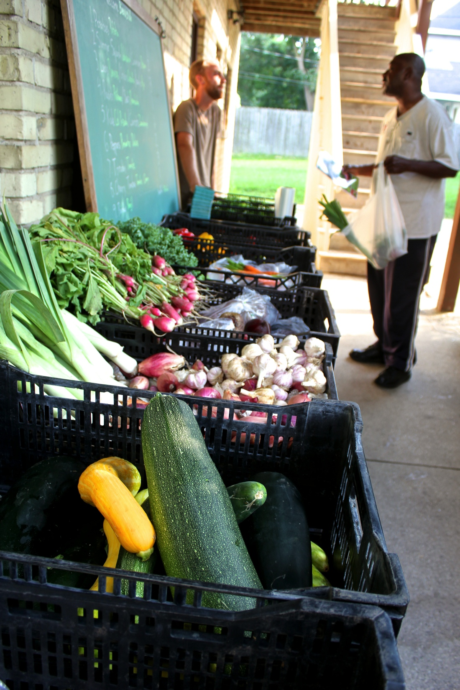
Cultivating Equitable Opportunities
Systems Change
Sacrificing the good for the unknown
Food co-op, bulk buying club, low cost grocer
Pantry Farm Markets

Slide 14
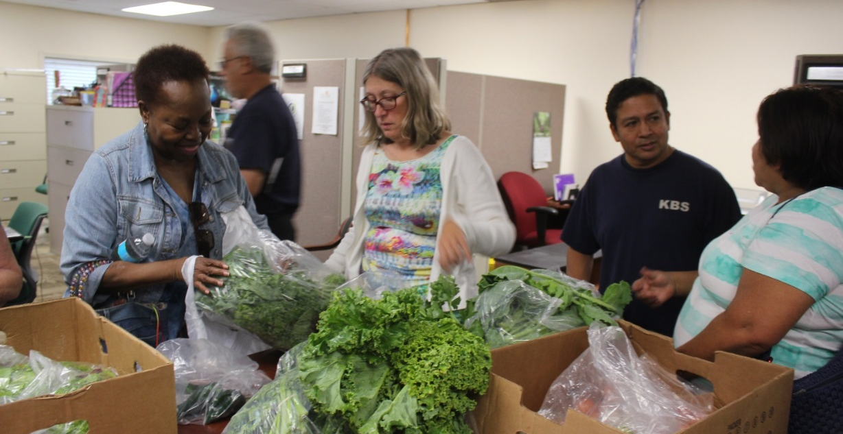
Investing in Local Food Economy
A win-win…
A more resilient ecosystem
Creation of jobs
Bolstering the local food economy
Preventing poverty & food insecurity
Community Supported Agriculture Program
Food skill building
Weekly supply of farm fresh food

Slide 15
Community Driven Engagement
Human-centered, neighbor driven
Privilege & power
Facilitators instead of fixers
Food justice and food sovereignty
Food Systems 101
History of US Food System, defining Good Food, Agriculture, food justice, community organizing
Community advocacy training

Slide 17
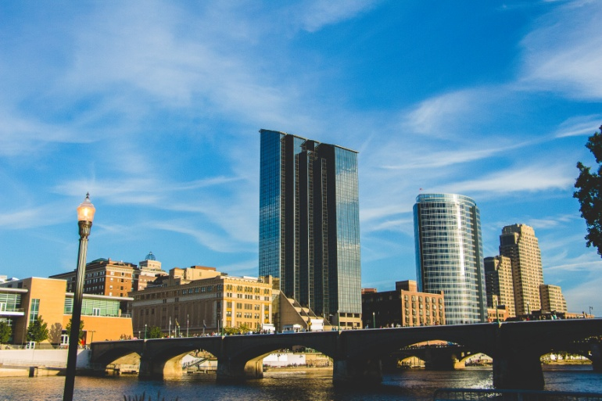
Access of West Michigan
Emma@accessofwestmichigan.org

