Slide 1

Defining Parameters of a Food Secure System
Jessica Gadomski MS, RD, LDN University of Illinois Extension- SNAP-Education
Notes:
Say: Good morning everyone, its been an exciting day, and I am thrilled to be here and kicking off our panel presentation to support County Coordination… My name is JG and I am an Extension Educator with the SNAP-Ed program focused on the implementation of policy, system and environmental efforts to create environments that promote healthy choice and access …
Say: In continuing the conversation on developing a food secure system here in DuPage County we need to take a step back and
Identify what eating for health means (common definition) which will then spring board us into
Discussing nutrition policies in the emergency food setting, agencies can implement to promote HEALTH
Say: So let’s get started…

Slide 2

Connecting Diet, Disease & Food Security
What impacts choice
Impacts of diet on health
Culture & Traditions
Surroundings (Environment)
Budget
Availability & Access
Preferences
Emotions
Knowledge
Risk Factors
Overweight & Obesity
High blood pressure
High blood cholesterol
High blood glucose
Low bone density
Chronic Disease
Heart Disease
Certain Cancers
Type 2 Diabetes
Stroke
Osteoporosis
Food insecurity impacts choices & increases risk for chronic diseases
Notes:
Say: Our lives are filled with choices, hundreds of them… many related to the foods- while a single choice might seem insignificant, over time the choices we make can have a major impact on our health and life!
Say: As shared earlier, there are many reasons and data behind why we are having this conversation and working towards a food secure system… there are multiple connections between diet, disease and food security … because of this we need to ensure we are creating environments and promoting choices that provide us with the best opportunity to live our lives to the best ability.
Say: Research has shown healthy eating, active living can lower your risk of many risk factors that can assist in preventing or delaying serious chronic diseases which are largely influenced by our lifestyle and choices. These diseases are among the main causes of disability and death in the US
Say: But there is more to it… your genetic make-up, age, gender, surrounding lifestyle and influences of environment and culture- in a food insecure climate there’s an increase in risk and additional hurdles that effect and impact choices and ultimately health (expand Hunger-Obesity Paradox- overweight and undernourished)

Slide 3

What are Healthy Foods?
(poll everywhere)
text JESSICAGADOM584 to #22333
Notes:
https://www.polleverywhere.com/my/polls
Say: So I want everyone to get their phones out and text to the number provided on the screen what comes to mind when you think about food and health… feel free to send multiple text as thoughts come into your mind…
Wait 1-2 minutes
Ask: As you’ve been sharing thoughts, a cloud has been forming on the screen, does anything stand out to you?
Highlight words/phrases within cloud that appear larger/most frequently
This allows audience to share their perspective and provides the group with “food for thought” as we move towards a common definition of health
Say: What a large mix of words and phrases you’ve shared… nutrition and living a healthful life can differ greatly between you and the person sitting next to you based on your personal experiences, thoughts and lifestyle, in order to move towards a healthful, food secure system we have to come together, identify and agree on what constitutes as healthful foods to encourage…
Say: Let’s take a look at how health is defined by our professionals …

Slide 4

Eat for Health
State of complete physical, mental and social well-being and not merely the absence of disease or infirmity
-World Health Organization 1948
Notes:
Say: So, in eating for health, we need to understand what health is … according to the WHO, health is the state of complete physical, mental and social well-being and not merely the absence of disease or infirmity- this is broad right, and a lot of the items mentioned in our poll can fit into this … it’s not just about getting food to families, it’s about getting nutritious foods families can grow on (quality over quantity)
Say: Eating healthy is a journey shaped by many factors, as shared on the previous slide, by eating for health we:
Higher quality of Life
Reduced Chronic Disease
Nourishment for the Body, Mind & Soul
Energy & Stamina
Positive Outlook
Enjoyment
Look & Feel Good
Environmental Impacts

Slide 5
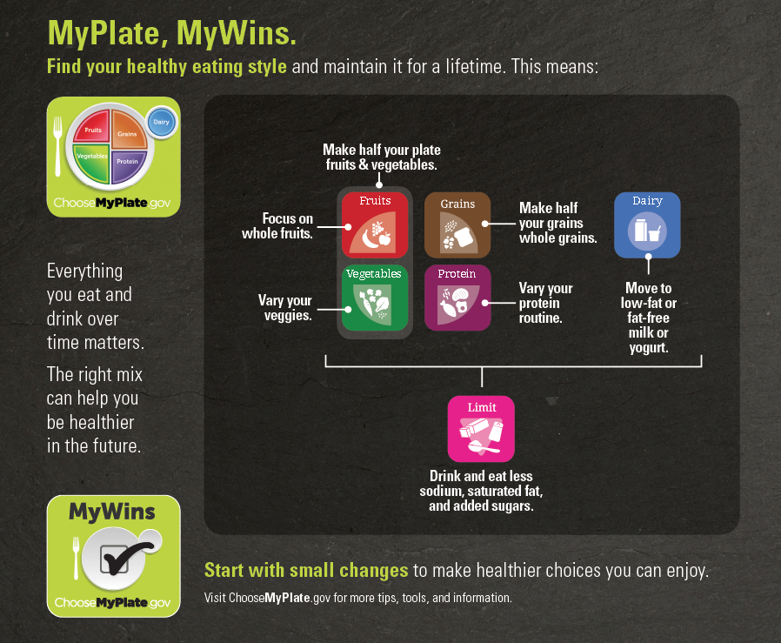
2015 Dietary Guidelines for Americans (DGAs)
2015-2020
Grounded in current scientific evidence
Recommendations intended to help individuals 2 years of age and older improve and maintain overall health and reduce risk of chronic disease
Used to develop Federal food, nutrition and health policies and programs
DietaryGuidelines.gov
Notes:
Say: Here in the United States, the DGA’s is our go-to guidance to assist us in eating for health.
Say: It’s recommendations are supported by scientific evidence, devised by a diverse group of professionals. These guidelines provide advice on:
making informed food choices and
consuming right amount of nutrients and calories
It’s main goal is to promote overall health and a healthy weight, to prevent or reduce the chance of chronic disease
Say: Unlike past versions of the guidelines- this version emphasizes overall eating patterns and the combination of all the foods and drinks that people consume every day
Say: The Dietary Guidelines is developed and written for a professional audience. Therefore, its translation into actionable consumer messages and resources is crucial to help individuals, families, and communities achieve healthy eating patterns. MyPlate is one such example. MyPlate is used by professionals across multiple sectors to help individuals become more aware of and educated about making healthy food and beverage choices over time. Created to be used in various settings and to be adaptable to the needs of specific population groups, the MyPlate symbol and its supporting consumer resources at ChooseMyPlate.gov bring together the key elements of healthy eating patterns, translating the Dietary Guidelines into key consumer messages that are used in educational materials and tools for the public.

Slide 6

Feeding America’s Foods to Encourage (F2E)
Help pantries evaluate the nutrition content of the foods they stocked
Recommendations not requirements
Inclusive of items that meet the DGAs
Intended to send a positive message
Focusing on specific food groups that are more widely accepted as contributing positively to good health and align with USDA MyPlate
Categories & Qualifying Criteria: Fruits & Vegetables, Grains, Protein, & Dairy
Feeding America’s Foods to Encourage Background (July 2015)
Notes:
Say: More specific to the emergency food setting, there has been an increased awareness of the need to improve the quality of foods provided to clients. Feeding America convened an advisory board and network nutrition task force to explore the meaning of “nutritious” (2012)
Say: Resulting in F2Es- recommendations for agencies to assist in evaluating food and beverages they stocked & identifying choices to encourage that align with the DGAs & MyPlate
Say: Criteria is listed for each category (F&V, Grains, Protein & Dairy) and includes limitations on Sodium, Saturated and Trans Fat and Total Sugar (protein example on screen)
Say: Agencies today are approaching their mission to end hunger more holistically to include additional opportunities for clients and their families to be physically, financially and emotionally healthy in their lives… to do this, agencies need more than just a list of recommendations of food. They need to explore and implement changes at the systems and environmental level, they need policy.

Slide 7
Why do we need Policy?
(poll everywhere)
text JESSICAGADOM584 to #22333
Notes:
https://www.polleverywhere.com/my/polls Say: Similar to when we thought about healthful foods, I want everyone to get their phones out and adding to the text string think about policy, what it does and why is it important … again, feel free to send multiple text as thoughts come into your mind…
Wait 1-2 minutes
Ask: As you’ve been sharing thoughts, a cloud has been forming on the screen, does anything stand out to you?
Highlight words/phrases within cloud that appear larger/most frequently
This allows audience to share their perspective and provides the group with “food for thought” as we move into discussing policy’s place in EF
Say: OK Let’s talk policy…
Say: Policy is a powerful tool, typically when it’s brought up this is the reaction that comes to mind is …

Slide 8

Notes:
Noooooo, why?!

Slide 9

Notes:
Sometimes people get on edge and wonder, what have I done wrong?

Slide 10

The Power of Policy
Communicates your position/stance to others
Can be tailored to fit your organization (broad, specific)
Holds us accountable
Keeps you on-track (guide)
Actionable
Free
Notes:
Say: but policy is a powerful tool that can result in a multitude of positive results!
Say: The power of policy is that:
It’s free, can be tailored to fit your agency’s needs
It keeps us on task, guiding our work and
Communicates our stance and purpose to others both within the agency and externally (to the community)
Say: Policies in the emergency food setting can ensure a clear plan is in place that promotes nutritious options and outreach
Say: It is a statement of organizational intent, how you conduct your business and how it aligns with your mission, vision and goals. Policy is everyone’s responsibility.

Slide 11
Developing your Policy
What to include
Purpose of the Policy
Guiding Principles
Purchased Products
Donated Products
Product Placement & Selection
Identify Policy Authority
Timeline for Policy Review & Revisions
UW Extension: Safe & Healthy Food Pantries Project Tools
Notes:
PASS OUT COPIES OF POLICY EXAMPLE
Say: So where do we start? It can seem very daunting or overwhelming, the policy provided is a great example from University of Wisconsin's Safe & Healthy Food Pantries Project. It is short and concise, covers a variety of areas (front and back of house) and can easily be expanded to be as specific or tailored as you’d like…
Say: There are important components to consider and include when developing a sound nutrition policy at your ef site…
The WHO/WHY- purpose
The WHAT/HOW- guiding principles and it’s impact on: purchased and donated items AS WELL AS HOW/WHERE food and beverages will be placed and promoted throughout your distribution site

Slide 12
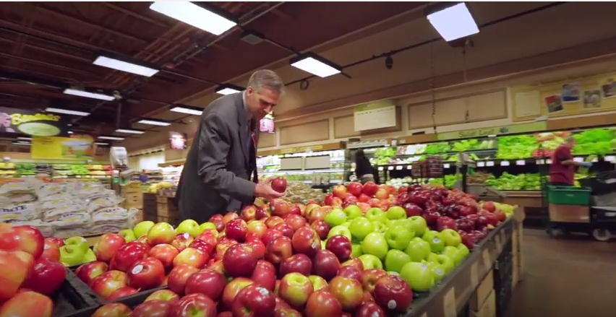
The Power of Nudges
Enhancing the Emergency Food Environment
Notes:
IF TIME PLAY YOUTUBE CLIP (3 minutes)
https://www.youtube.com/watch?v=aJmgN5wavNY
Say: To sum it up… The result of defining parameters in the foods you will encourage/promote and policies for their implementation (environmental and systems changes) can enhance and support the health of your clients.

Slide 13


