Slide 1

A Kane County Food Hub Project: Connecting Local Growers, Wholesalers and Institutional Buyers
Matt Tansley
Land Use Planner
Kane County Development and Community Services
September 21, 2017

Slide 2

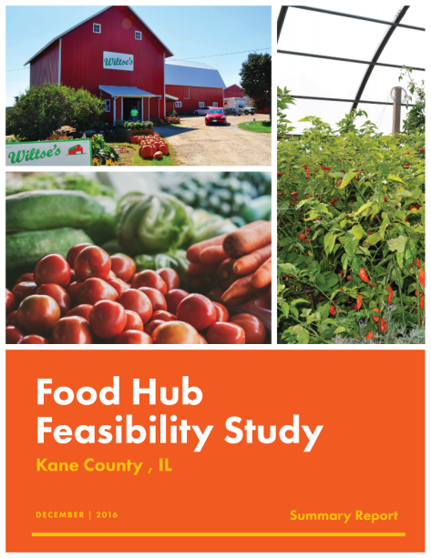
Growing for Kane Initiative and Food Hub Feasibility Recommendation
HIA REPORT RECOMMENDATION
Recommendation | Result
Kane County should work with Northern Illinois Food Bank (NIFB) and Kane County Farm Bureau to study the feasibility of locating a food hub. | Farmers have motivation to grow more produce with centralized cleaning, packaging and distribution available off farm.

Slide 3

What is a Food Hub?
Centralized aggregation, processing and distribution
Connects small to mid-sized producers with larger buyers
Specialized services: product marketing, food processing and safety training
Who does it serve?
Agricultural Producers
Restaurants & Food Retailers
Health Providers
Schools / Public Institutions
Wholesale Distributors
Community Organizations

Slide 4
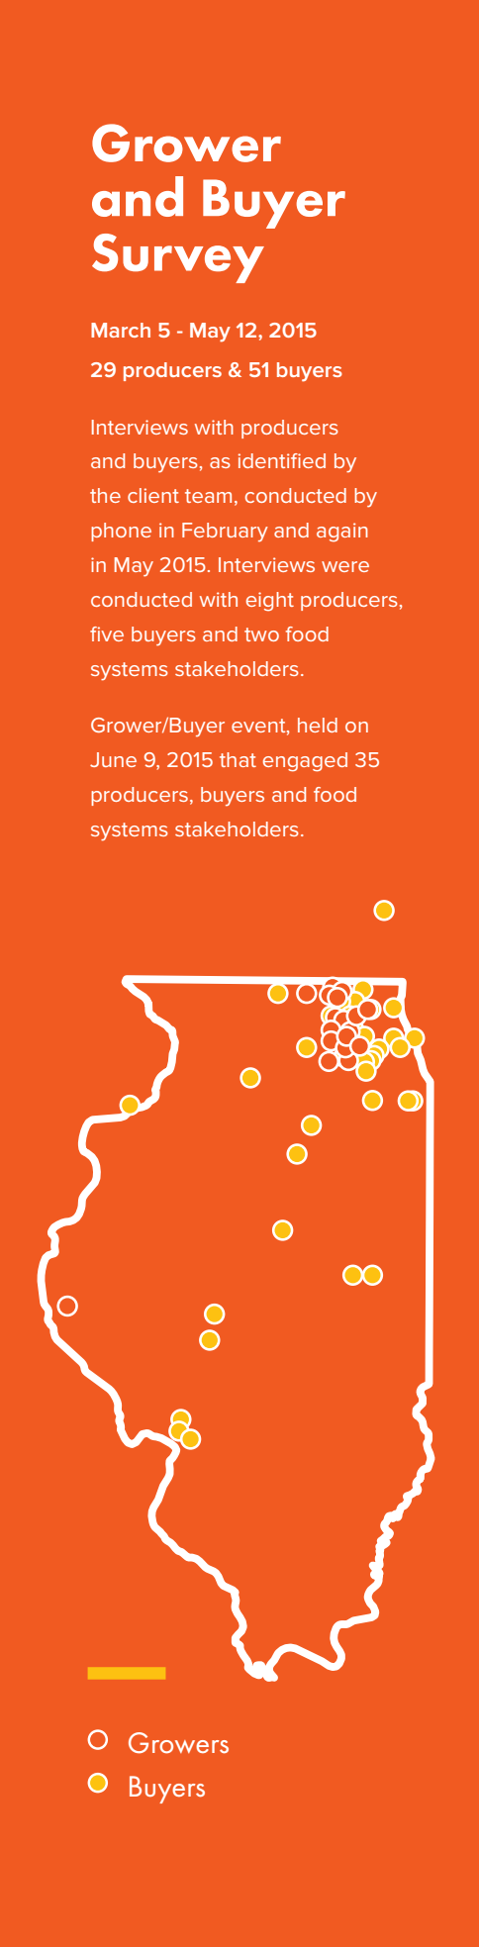
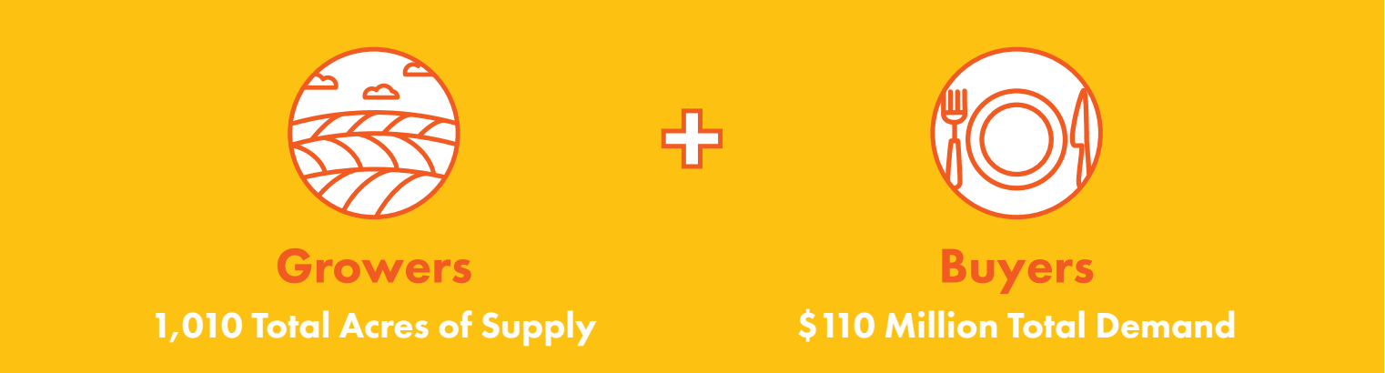
The Food Hub Feasibility Study What we Learned about the Market…
Interested producers/farmers account for:
850 acres of current fruit & vegetable production
160 acres of potential expansion
Interested wholesale buyers account for:
$53 million in spending on whole produce
$26 million in spending on processed produce
$31-$35 million in spending on meat, dairy, eggs

Slide 5

Growers’ Top Barriers for Entering the Wholesale Market (Feasibility Study grower survey results)
Fair pricing
Cost, time, labor to implement GAP protocols
Risk of not selling what is grown
Access to post-harvest handling facilities (cooling, washing, grading, packing)

Slide 6
Need for Health Equity Focus
Kane Population – Access to affordable fresh produce (2014 Community Health Survey)

Slide 7
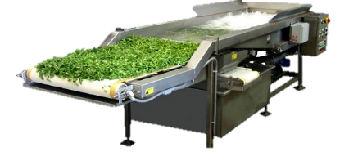
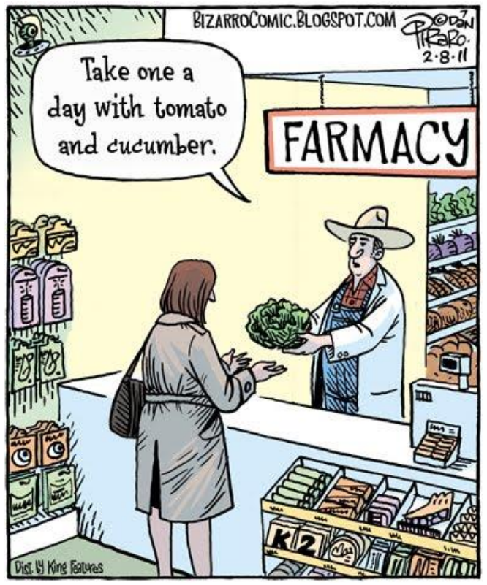
Health Equity Addressed in Hub Operating Model
Strategy 1
Specialized Processing
Demand among schools for processed fresh-cut produce for use in cafeterias
Strategy 2
Fresh Produce Prescription Box Program
Hub to sell CSA-style weekly produce boxes to SNAP recipients through partnership with healthcare providers

Slide 8


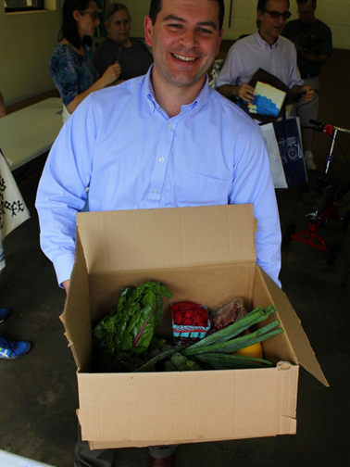
Prescription Produce Program Recent Activity
Project team has developed a proposal for a pilot program and is continuing to pursue grants.
Health service partner Rush-Copley, has committed to recruiting up to 50 patients to participate in a prescription produce pilot.
Pilot proposal would offer nutrition education and cooking demonstration workshops for participating patients
Future food hub operator has committed to handle aggregation from local farmers and delivery to the pickup site.

Slide 9
Business Analysis & Financial Assumptions (at 3-year operating period)
This food hub would require…
an 8,000 sqft warehouse
And would generate…
$3.4 million in sales and $150 thousand in cash flow.
Based on scenario testing, the hub could maintain profitability and withstand fluctuations in pricing, volume, and margin by plus or minus 15%.

Slide 10


Operator Recruitment & Public / Private Partnership
Identify a qualified operator to run and/or own the hub
Preference for operator experienced working with farmers
Selection criteria to include adherence to recommendations of the Feasibility Study
Transition of project management from the County to the operator

Slide 11

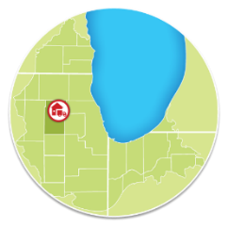
Food Hub Project Timeline
2017
Food Hub Site Search
Selection Committee Reviews Operator Candidates
Summer
Agriculture Committee to Review Operator Recommendation & MOU
County Board Authorization & Signed Memorandum of Understanding
Fall
Operator & Consultant Business Planning Begins
Winter
Farmer Readiness:
Wholesale Training Workshop
2018
Institutional Readiness:
JJC Food Procurement & Youth Demonstrations
Spring
Food Hub: Financing Plan, Fundraising & Marketing
Summer
Food Hub Operator: Facility Retrofit & Purchase of Equipment

Slide 12

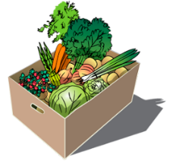


Food Hub Readiness: Health Equity Partnership
& Farmer Readiness
Health Equity Partnership
(Rush-Copley Foundation)
The Food Hub or a pilot aggregator will buy farm produce and distribute CSA veggie boxes through health partner referrals
Build the hub’s capacity to assist farmers in meeting wholesale readiness requirements
Project video to build support for program elements
Food Hub
Institutional Readiness
(Kane County
Juvenile Justice Center)
Health screening & patient referrals to receive prescription produce boxes
Nutrition education services
Farmer Readiness
Farmers and farm networks will sell product to the hub
The hub will assist farmers with planning and meeting wholesale readiness requirements
Technical assistance for institutions (Juvenile Justice Center) to adapt food procurement practices
Teacher training and food tasting demonstrations to identify student preferences

Slide 13




















Our Project Team and Contributors

Slide 14
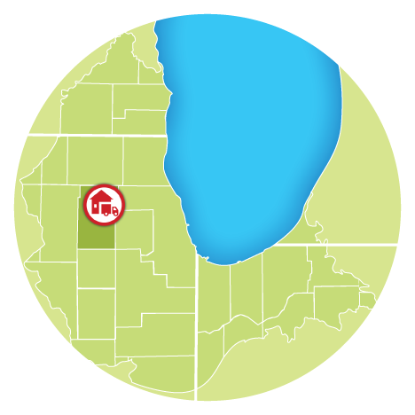
Questions?
Matt Tansley
tansleymatthew@co.kane.il.us
630-232-3493
Food Hub Project Website
http://www.countyofkane.org/FDER/Pages/foodHub.aspx
Kane County Government Center
719 S. Batavia Avenue
Geneva, IL 60134

