Slide 1
DuPage
Food Security Council
April 23, 2018

Slide 2
Food Security Symposium
Building food systems that are accessible, sustainable and health promoting across all cultures and economic levels

Slide 3
Food Councils
Promote strong food systems across communities
Use a cross-sector approach
Set shared community goals around target areas

Slide 4
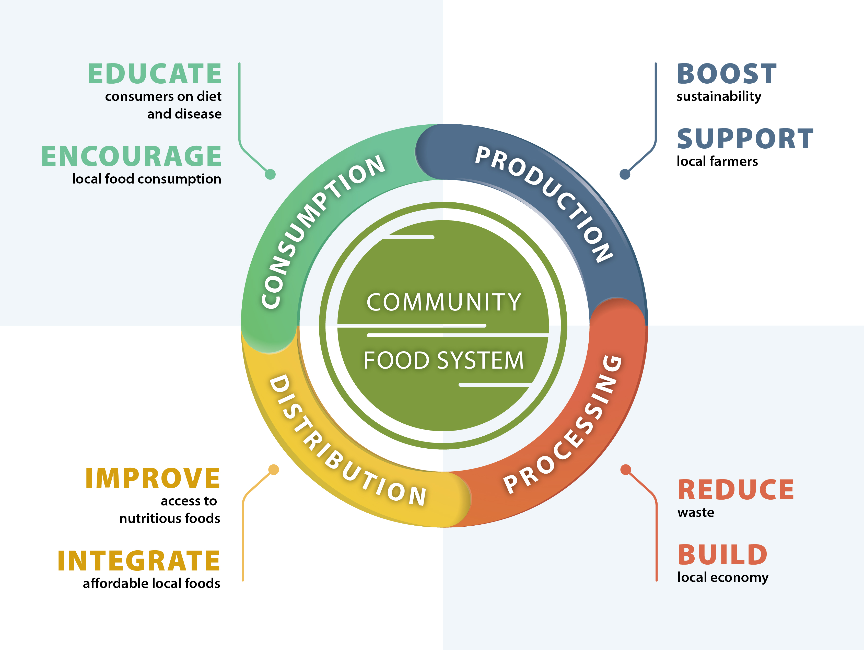

Slide 5
Food Councils
Public health officials
Farmers and agricultural organizations
Schools, colleges and universities
Emergency food providers
Retail organizations
Other support organizations
Who
should be
involved?

Slide 6
April 23 Discussions
Accomplishments through subgroups
Defining Parameters of a Good Food System
Coordinating with Growers
Nutrition Education & Community Training
Food Security in DuPage County
Group discussions –
Food Security Indicators

Slide 7
Polling Everywhere Instructions
Text CHRISTINALEP512
to 22333
to connect to the poll

Slide 8
Defining Parameters
Develop community indicators (measures) that support and assess healthy food systems

Slide 9
Defining Parameters
Demographic &
Socioeconomic
Factors
Poverty level
Employment level
Population
Ethnicities
Cost of living index
Market basket affordability index

Slide 10
Defining Parameters
Health
Indicators
Children & adolescents who are obese
Low income preschool obesity
Adult fruit & vegetable consumption
Hospitalization rate due to complications of diabetes

Slide 11
Defining Parameters
Persons receiving SNAP
WIC enrollment
Emergency food resources
School programs: free & reduced lunch
LINK card redemption outlets
Senior feeding programs
Public Benefit
Program
Availability

Slide 12
Defining Parameters
Food insecurity rate
Child food insecurity rate
Households with no car and low access to a grocery store
Food insecure children likely ineligible for assistance
Severe housing problems
Household Food Insecurity levels

Slide 13
Defining Parameters
People with low access to a grocery store
People 65+ with low access to a grocery store
Low income and low access to a grocery store
Fast food restaurant density
Food outlet availability & accessibility

Slide 14
Defining Parameters
Farmer’s market density
Community gardens / CSA’s / food coops
Inventory of community agricultural land zoning
Use of locally grown products in school foodservice programs
Local agricultural support

